Slide 1
CH: 13/14 Persuasive Speaking & Logical Reasoning
Brandon Straight

Slide 2
Defining Persuasion
Information + Change = Persuasion
The process of creating, reinforcing, or changing people's beliefs or actions

Slide 3
Know Your Goal
Are you attempting to change
Attitudes
Beliefs
Values
To motivate to action
Notes:
Think of your audience on a continuum of supporting you or strongly opposing you

Slide 4
Cultural Significance
Individualist cultures
Emphasize the individual
Collectivistic cultures
Emphasize the group or family
High power distance cultures
Large difference between those who have power and those who don’t
Low power distance cultures
There is difference
Notes:
Individualistic- US UK Canada
Collectivistic- south America, china, Japan
High power- Mexico, india, phillippines
Low power- new Zealand, Sweden, US in some contexts

Slide 5
Cultural Significance cont.
High-ambiguity-tolerant cultures
Don’t feel threatened by uncertainty
Low-ambiguity-tolerant cultures
Try to avoid uncertainty at all cost
Masculine cultures
Emphasis masculine values of strength
Feminine cultures
Emphasis values of intimacy and relationships
Notes:
High ambiguity- britain, Jamica, US
Low ambiguity- spain Greece Japan
If countries have a lot of uncertainty they want expert testimiony and tradition (low ambiguity) pg. 222 this is very confusing I have always learned this as a different term
Masculine- Japan Mexico Jamaica Germany
Feminine- Netherlands, Thailand

Slide 6
Cultural Significance cont.
High context cultures
Not as high of a need for verbalization of content
Low context cultures
Higher need for verbalization of content
Short and long term oriented cultures
Spend now and enjoy now vs future rewards
Indulgent and restrained cultures
Freedom to do what you want, and leisure time vs curbing gratification
Notes:
High- Japan, korea
Low- American, Germany
Use example of Americans failing at business
Pg. 223 for examples

Slide 7
Tips on Persuasion
Identify with your audience
Secure a yes response
Anticipate selective exposure
Listeners seek out info. That coincides with their beliefs
Use positive labeling
Ask for reasonable levels of change
Provide social proof
Herd instinct mentality
Notes:
Pg. 225-226

Slide 8
Monroe's Motivated Sequence
Attention
Need
Satisfaction
Visualization
Action
Notes:
How businesses use this
https://www.youtube.com/watch?v=rIK-q6JoOeU

Slide 9
3 Proofs of Persuasive Speech's
Logos
Use logic/ reasoning from specific instances
Pathos
Use emotional appeals/ appeal to Maslow's hierarchy of needs
Ethos
Use credible information to appeal.
Competence
Character

Slide 10
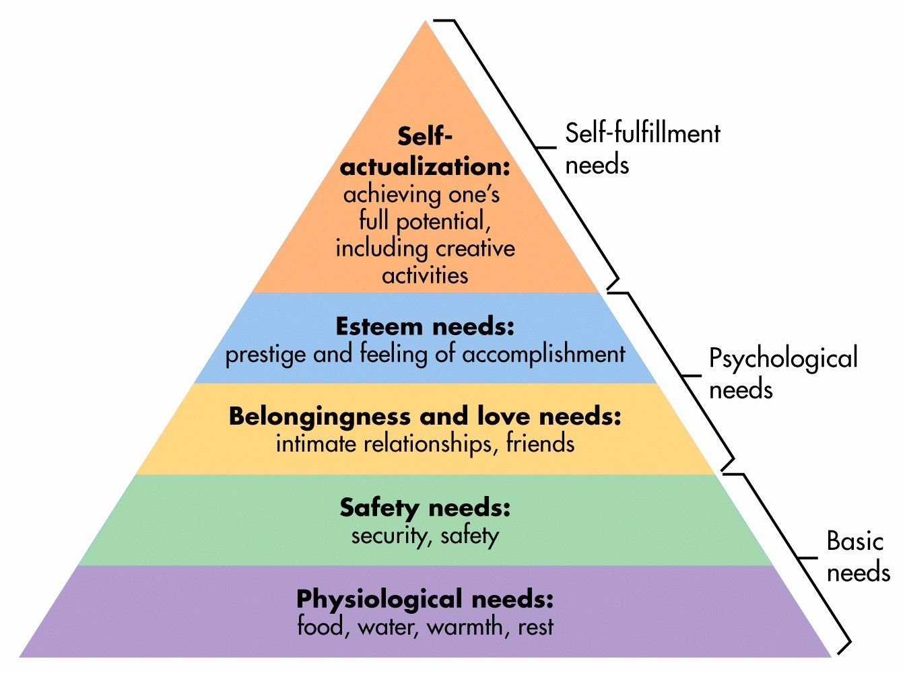
Maslow’s Hierarchy of Needs
https://www.simplypsychology.org/maslow.html

Slide 11
3 Types of Persuasive Speeches
Persuasive Fact
To persuade listeners something is true or false
Persuasive Value
To persuade listeners in the value of something, that it is good, moral, or just
Persuasive Policy
To persuade listeners that this is the policy to adopt or not adopt.

Slide 12
Reasoning
Analogical reasoning- drawing conclusions about an object based on its similarities to something else.
Figurative analogy- an analogy where the two things under comparison are not essentially the same
Literal analogy- an analogy where the two things under comparison have sufficient or significant similarities to be compared fairly.
Inductive reasoning- reasoning from an example or specific instance.
Deductive reasoning- the conclusion is based on the combination of multiple premises that are generally assumed to be true.
Generalization- draws from recurring patterns or repeated observations

Slide 13
Fallacies
Slippery slope- Once one thing begins you cannot stop the next
Straw man- Shows only the weaker side of an opponent's argument in order to more easily tear it down
Appeal to tradition- traditional practice and long-term history is the only reason for continuing a policy
Bandwagon- something is popular so it is good.
Red herring- creates a diversion by introducing an irrelevant point
Ad hominem- attacks the person over the actual issue in the fight

Slide 14
Summary
What topics are you considering?
Is there any intercultural significance you should acknowledge?
What are some effect methods you learned today to persuade someone.

